Slide 1
Linux Getting Help…

Slide 2
World’s biggest help file…
Google!

Slide 3
Man pages
# man command_name
Pages have multiple sections
apropos command – if it fails, run mandb

Slide 4
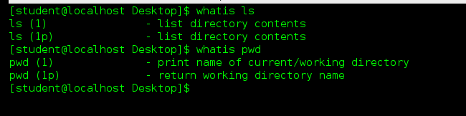
Whatis
Provides a brief description of the command in question.
No details…

Slide 5
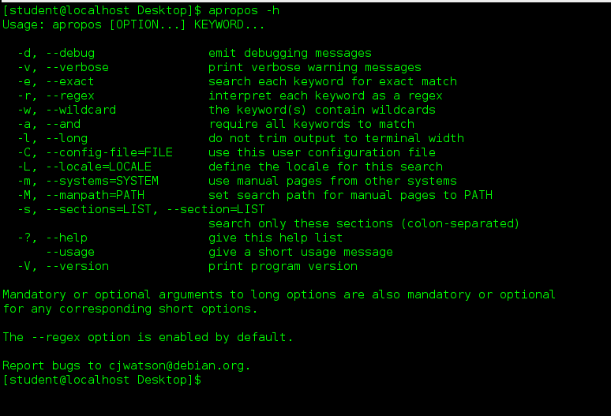
“dash h”
Most but not all commands come with a built in “help” switch:

Slide 6
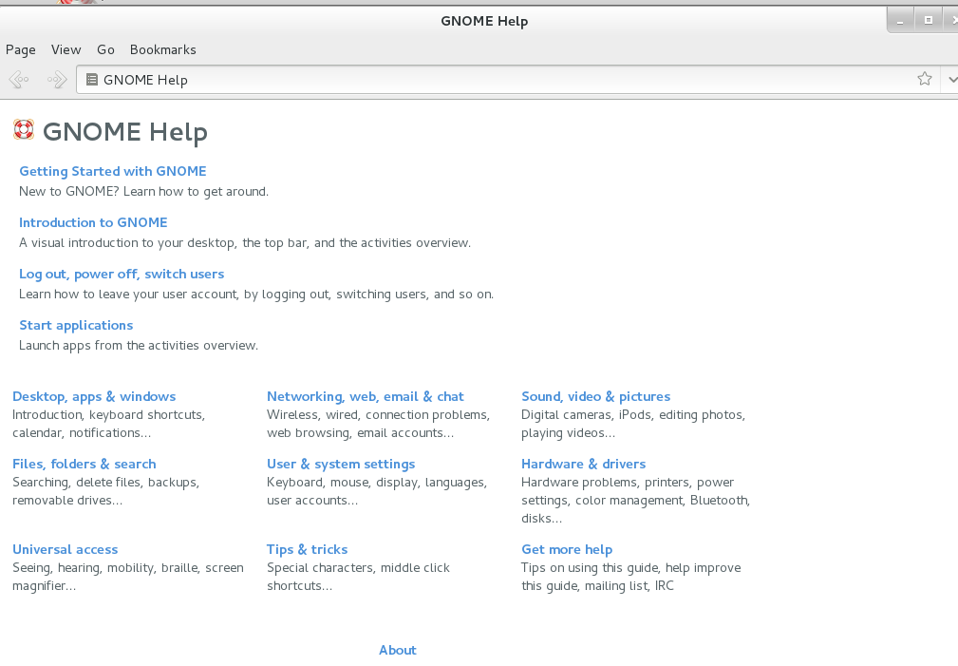
GUI help…
YMMV

Slide 7
Lab Exercise – Getting help
On your VM, perform Lab 4.

